Slide 1
Swiggy Sales & Delivery Performance Dashboard
AUTHOR
PRIYANKA K

Slide 2
This project focuses on analyzing Swiggy sales and delivery performance using a dataset of 5000 rows. The goal is to derive insights into sales trends, delivery efficiency, and customer satisfaction using Microsoft Power BI.
Project Overview

Slide 3
Problem Statement
Food delivery platforms generate massive amounts of data daily. However, extracting meaningful insights from raw data is challenging.
Key challenges:
Understanding city-wise sales performance
Identifying delivery delays
Analyzing customer ratings
Improving operational efficiency

Slide 4
Project Objectives
Analyze total sales by city and restaurant
Evaluate delivery time performance
Identify top-performing cities and items
Measure customer satisfaction using ratings
Build an interactive dashboard

Slide 5
Dataset Information
Total Rows: 5000
Columns:
Order_ID
Order_Date
City
Restaurant_Name
Category (Veg/Non-Veg)
Item_Name
Quantity
Price
Delivery_Time (mins)
Rating

Slide 6
Data Cleaning (Power Query Editor - ETL Process)
Extract
Imported dataset into Power BI
🔹 Transform
Removed duplicates
Handled missing values
Changed data types
Created calculated columns
Filtered incorrect data
🔹 Load
Loaded cleaned dataset into Power BI model

Slide 7
Key Metrics (DAX Measures)
Total Sales
Average Delivery Time
Average Rating
Total Orders
Top 5 Cities by Sales

Slide 8
Dashboard Features
Sales by City (Bar Chart)
Delivery Time Analysis (Line Chart)
Ratings Distribution (Pie Chart)
Top Cities & Restaurants
KPI Cards

Slide 9
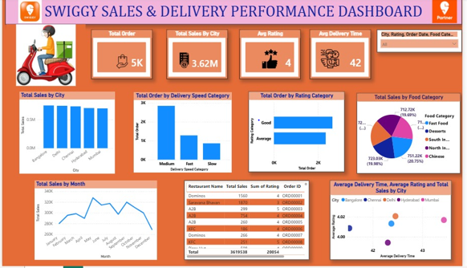
Dashboard Preview

Slide 10
Tools & Technologies Used
Microsoft Power BI
Power Query Editor (PQE)
DAX

Slide 11
Conclusion
Improve delivery efficiency
Increase customer satisfaction
Make data-driven decisions

